Slide 1
Bachat-Pay – AI Agent for Digital Financial Empowering India with Safe Digital Finance
IBM HACKATHON PROJECT
Presented By: Shubham Kumar Pandey
Student name : Shubham Kumar Pandey
College Name & Department : Parul Institute of Technology

Slide 2
OUTLINE
Problem Statement | Quick Start Questions
Technology Used | Tools Used & Testing
IBM Cloud Services Used | Deployment & Preview
Wow Factor | API Reference After Deployment
End Users | Resources List
Setting Up | Results
Agent Instructions | Conclusion
 | GitHub Link
 | Future Scope
 | IBM Certifications

Slide 3
Problem Statement
An AI Agent for Digital Financial Literacy, powered by RAG (Retrieval-Augmented Generation), helps users understand and navigate essential financial tools and practices. It retrieves reliable content on using UPI, avoiding online scams, understanding interest rates, budgeting, and personal finance management from government portals, banking websites, and educational platforms. With multilingual support, users from diverse backgrounds can interact in their preferred language and ask questions like “How do I send money via UPI?” or “What is a safe interest rate for a loan?” The agent ensures financial literacy is accessible, personalized, and culturally inclusive. This AI-driven assistant empowers users with knowledge, protects them from fraud, and builds confidence in digital finance

Slide 4
Technology used
IBM cloud lite services
Natural Language Processing (NLP)
Retrieval Augmented Generation (RAG)
IBM Granite model
IBM Watsonx.ai Studio

Slide 5
IBM cloud services used
IBM Watsonx AI Studio
IBM Watsonx AI Runtime
IBM Cloud Object Storage
Vector Index
Granite Foundation Model

Slide 6
Wow factors
This agent significantly enhances financial confidence, safety, and literacy by providing real-time, document-based answers in user-friendly language.
Unique Features:
RAG-based answers from RBI, NPCI, and SEBI documents
Multilingual support – Responds in Hindi or English automatically
Explains financial terms like EMI, UPI Autopay, interest rates
Scam protection tips fetched from trusted sources
Simple explanations for complex topics using natural language
Deployable via API in web/app/chatbot interfaces
Built entirely on IBM Watsonx + Granite + Cloud Lite

Slide 7
End users
Rural & urban citizens
Students & beginners
NGOs promoting financial literacy
Elderly new to UPI
Small business owners

Slide 8
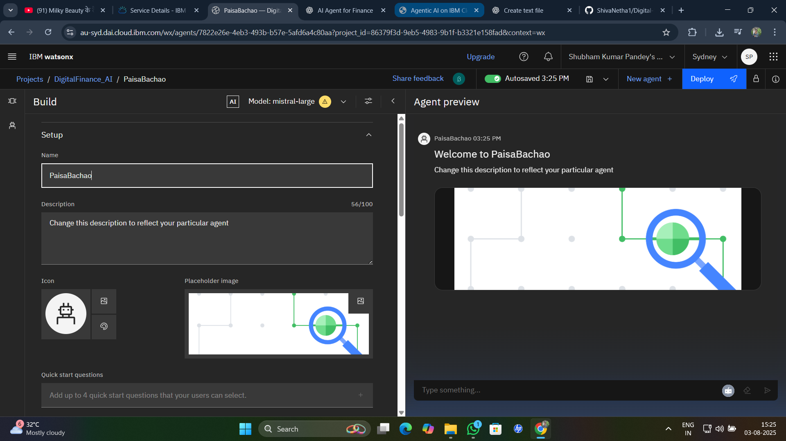
Result
Setting Up
Create Watsonx Project
Upload documents: UPI, Loans, Scam PDF
Create Vector Index
Select Granite Model
Configure Agent & Instructions
Test, Save & Deploy

Slide 9
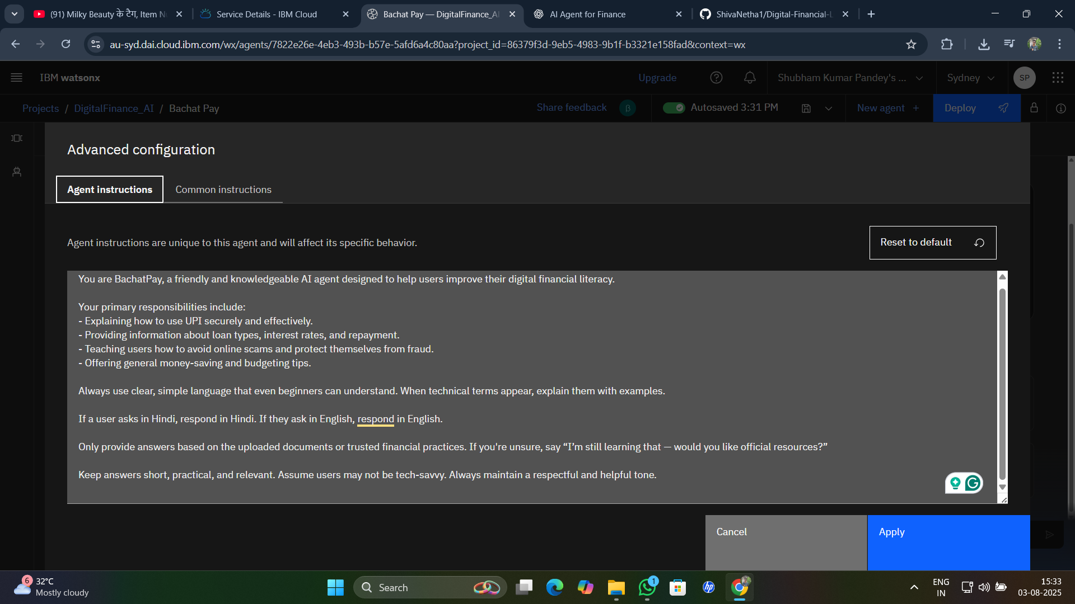
Results
Agent Instruction
You are BachatPay, an AI agent that answers finance-related questions in simple language. If user inputs Hindi/Hinglish, respond similarly. Be brief, accurate, and only use uploaded document facts.

Slide 10
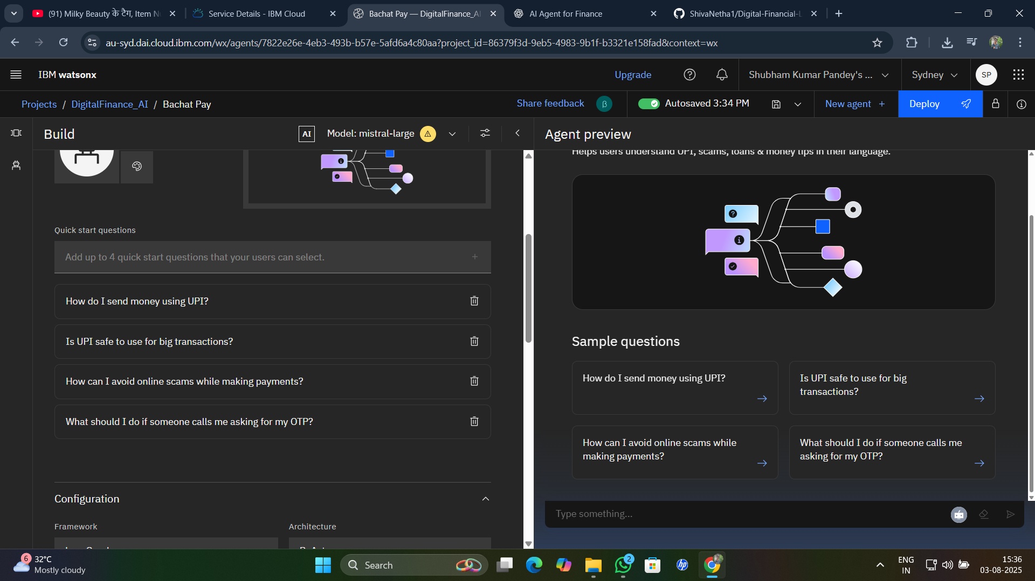
Results
Quick Start Questions
How do I send money via UPI?
What is UPI Autopay?
What is a safe interest rate?
How to avoid scams?

Slide 11
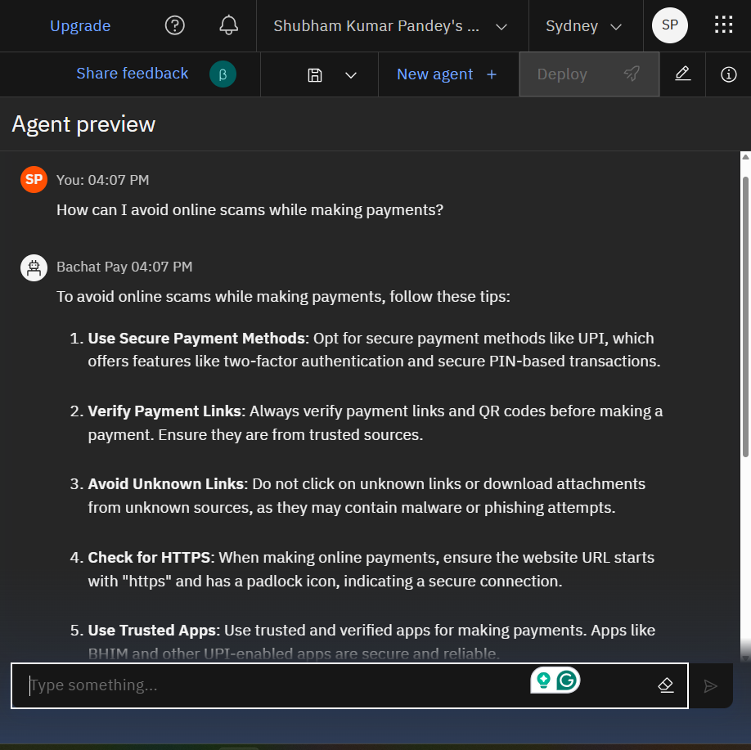
Results

Slide 12
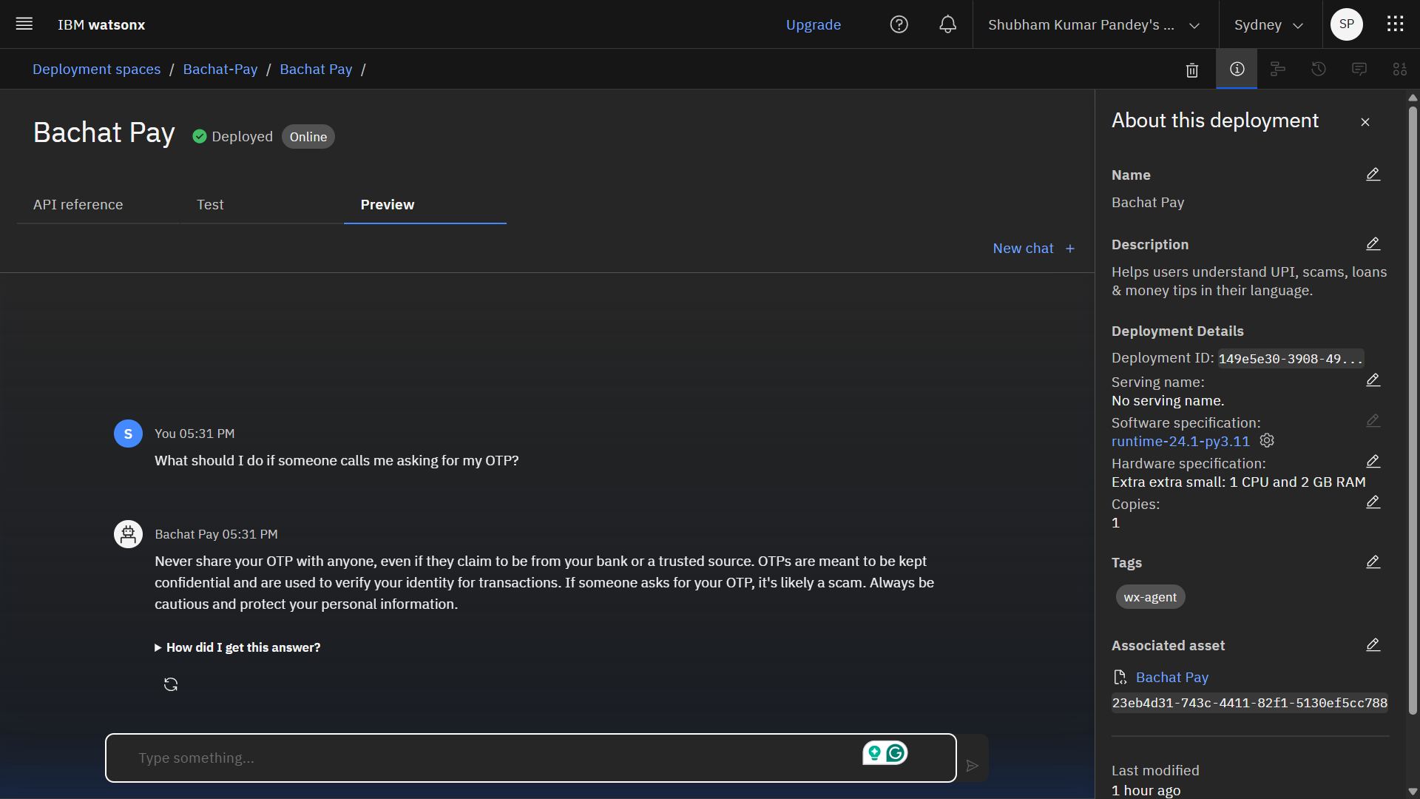
Results
Deployed AI Agent
Created 'Bachat-Pay' deployment space
Agent deployed successfully
Tested live in IBM Preview Window
Supports real-time interactions

Slide 13
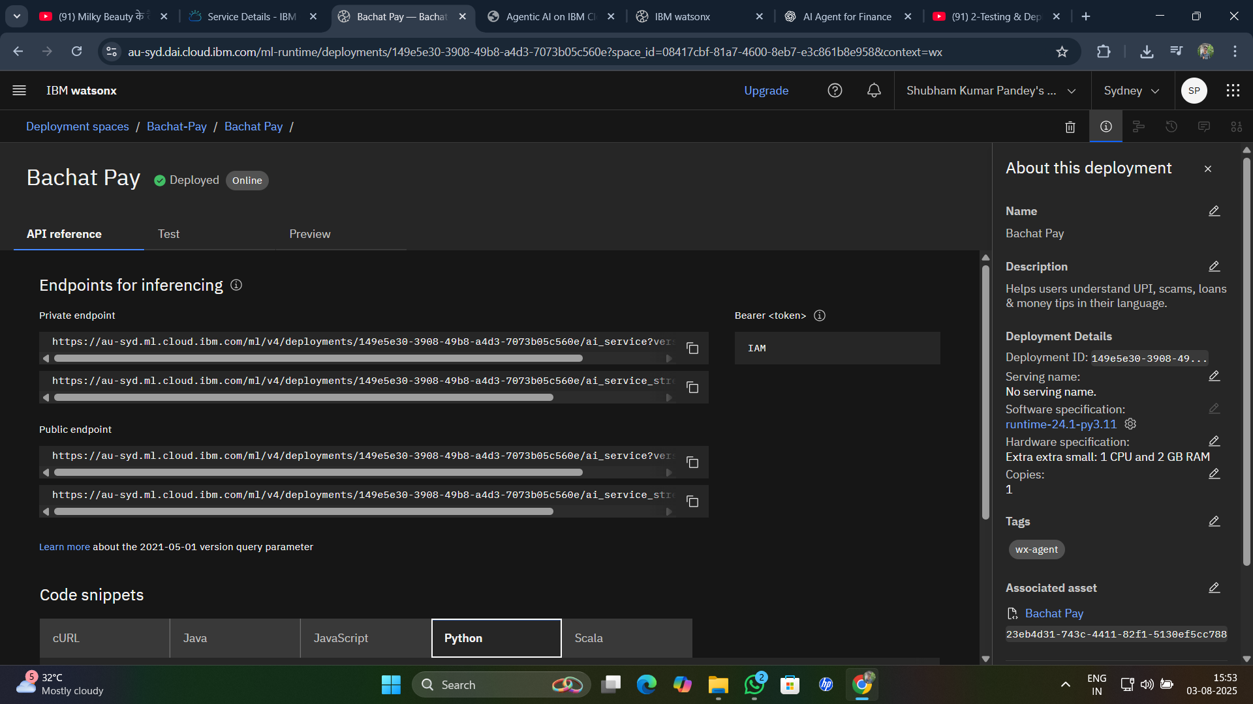
Results
API Reference After Deployment
Agent endpoint available
Tokenized access
Can be integrated in:
Web apps
Chatbots
Mobile apps

Slide 14
Conclusion
Bachat-Pay empowers users with accessible, trusted, and multilingual digital finance guidance.
Helps citizens understand UPI, loan interest rates, and scam prevention
Uses AI + RAG to give accurate answers from verified documents
Automates the role of a digital financial advisor, available 24×7
Promotes financial confidence, safety, and inclusion in India
Bridges the gap between users and trusted financial knowledge
Ready to scale through API, chatbot, and app integrations

Slide 15
GitHub Link
Make sure that there should be readme file

Slide 16
Future scope
Voice assistant (Hindi)
WhatsApp chatbot
Real-time financial data APIs
Regional languages (Marathi, Tamil)
QR fraud scanner

Slide 17
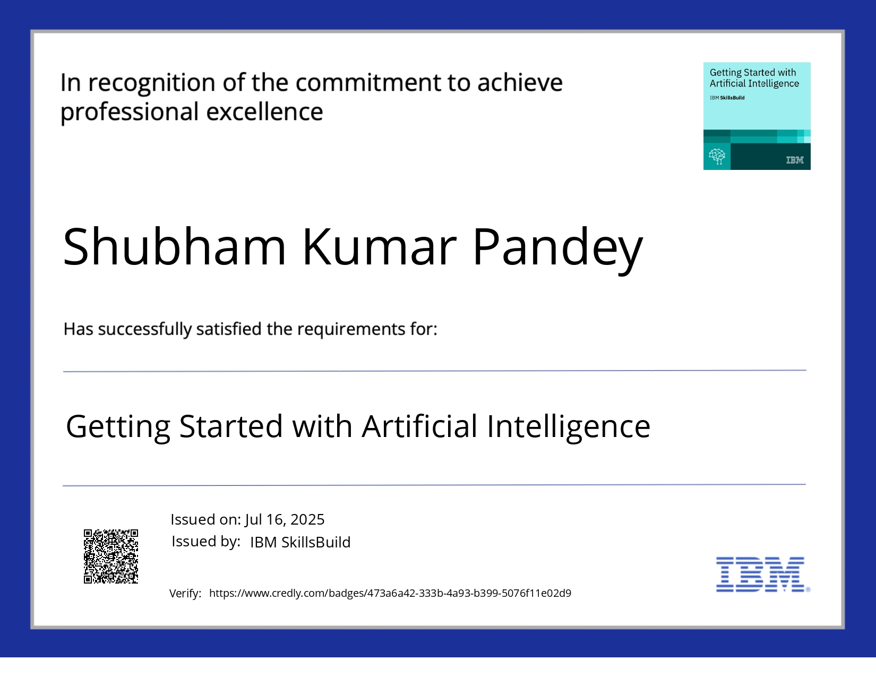
IBM Certifications
Screenshot/ credly certificate( getting started with AI)

Slide 18
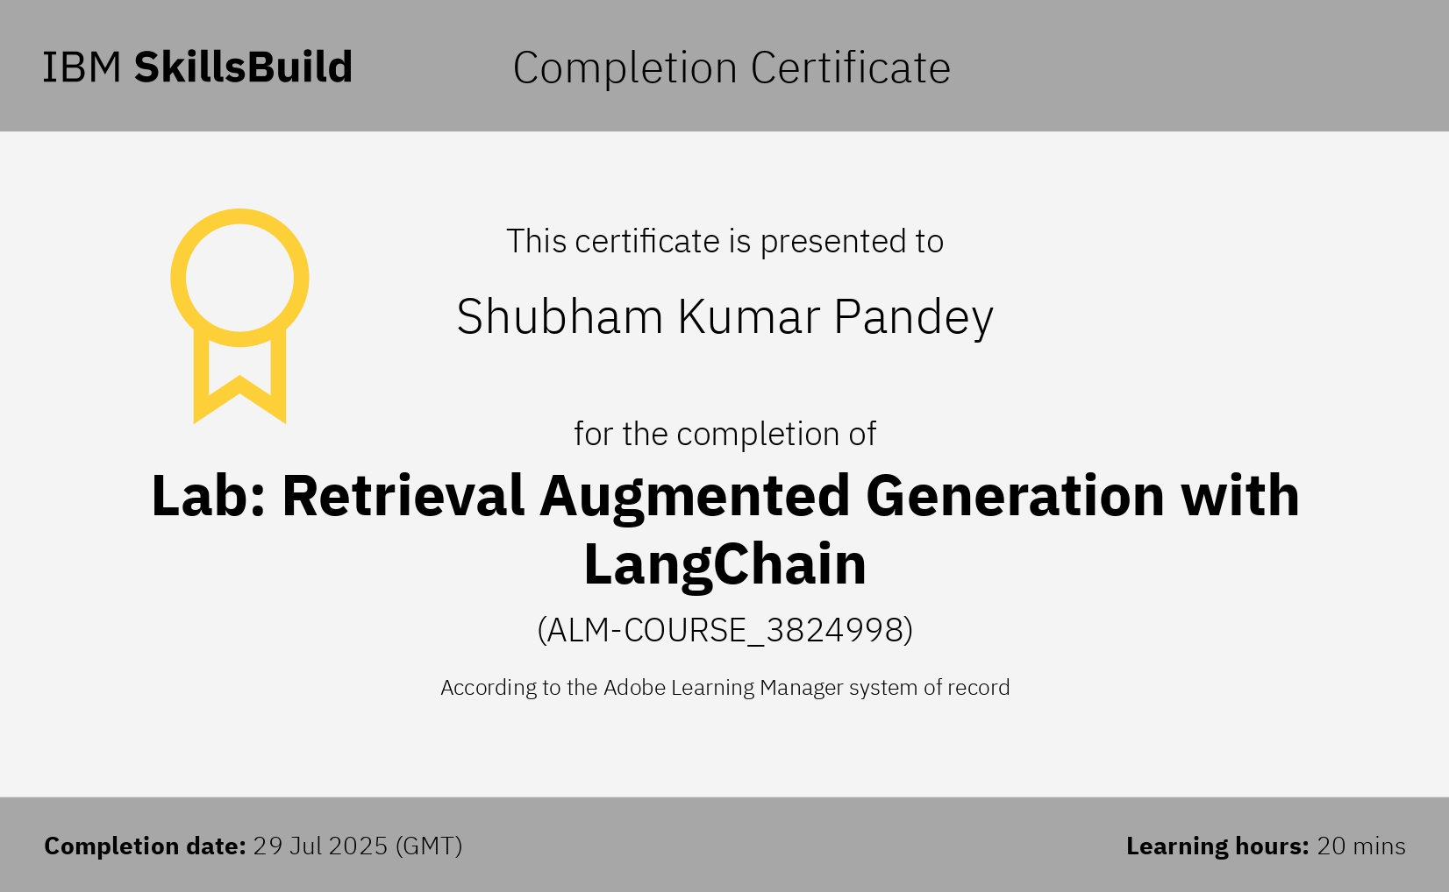
Attach your RAG LAB certificate here

Slide 19
THANK YOU

